Slide 1
PYTHON PROJECT
REYTA AKDENİZ

Slide 2
Objectıves
CLASSIFY TWEETS IN THE DATASET BASED ON THEIR STANCE TOWARD THE BOYCOTT.
MAKE A LOGISTIC REGRESSION TO UNDERSTAND WHICH SENTIMENTS/EMOTIONS PREDICTS THE BOYCOTT STANCE

Slide 3
Objectıves
CLASSIFICATION
LOGISTIC REGRESSION

Slide 4
TASKS
CLASSIFICATION
Labeling;
Account type: personal vs. non-personal
Relevance: relevant vs. irrelevant
Stance: pro-boycott, anti-boycott, neuter
Filtering:
Account type: personal
Relevance: relevant

Slide 5
PROCESS
CLASSIFICATION -1
Extracted a 200 tweet data for testing
Label account type by hand
Label account type w/ gpt
Checked confusion matrix and hypermetrics for performance (Precision)
Fine-tune prompt if necessary
Filtered non-personal accounts out

Slide 6
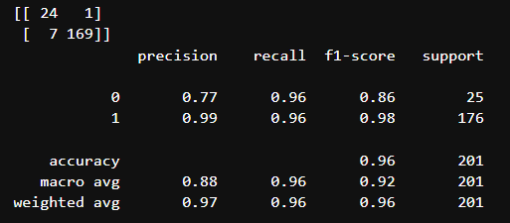
Account type-report

Slide 7
PROCESS
CLASSIFICATION -2
Label relevance by hand
Label relevance w/ gpt
Checked confusion matrix and hypermetrics for performance (Precision)
Fine-tune prompt if necessary
Filtered irrelevant tweets out

Slide 8
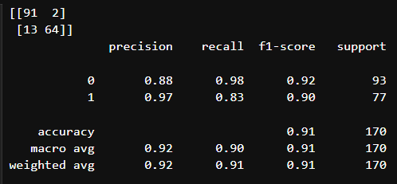
Relevance-report

Slide 9
PROCESS
CLASSIFICATION -3
Label stance by hand
Label stance w/ gpt
Checked confusion matrix and hypermetrics for performance (F1)
Fine-tune prompt if necessary

Slide 10
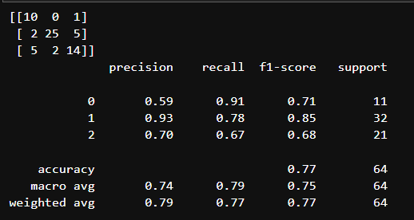
STANce-report

Slide 11
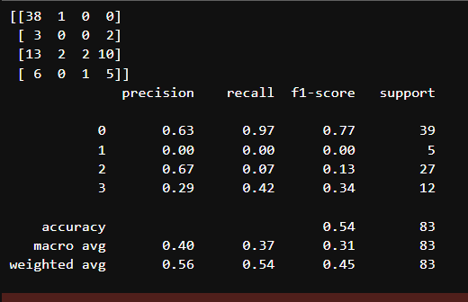
FAILURE VOL. 74398

Slide 12
PROCESS
LOGISTIC REGRESSION
Convert variables to dummies
Replace True-False with 1-0
Check for multicollinearity, and other issues
Exclude variables with no valid cases
Run the analysis

Slide 13
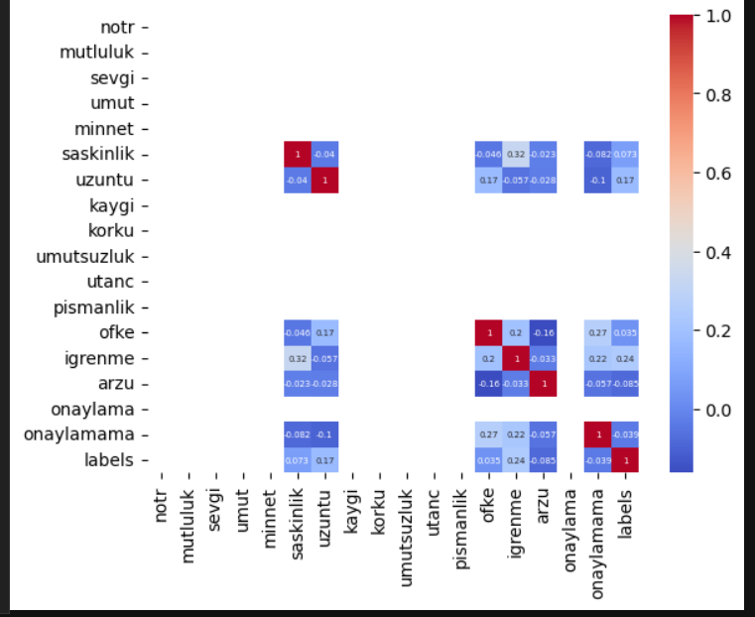
Logıstıc regression-report

Slide 14
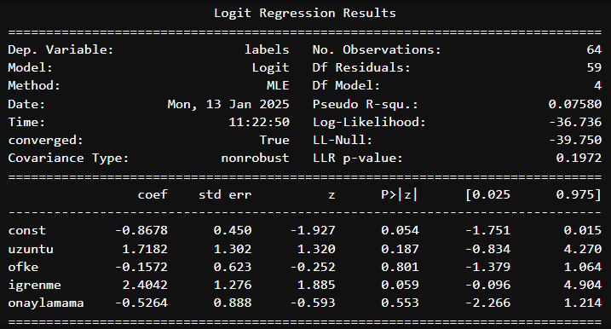
Logıstıc regression-report

Slide 15
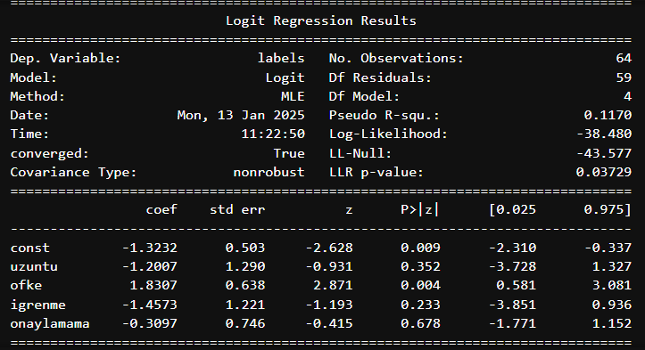
Logıstıc regression-report

